Slide 1
Algorithms Design and Analysis
Course Introduction
Chaklam Silpasuwanchai

Slide 2


Course Overview
Instructor: Chaklam Silpasuwanchai
Email: chaklam@ait.asia
Course materials @ GDrive:
http://chaklam.com
Google classroom code: zva6bh7

Slide 3
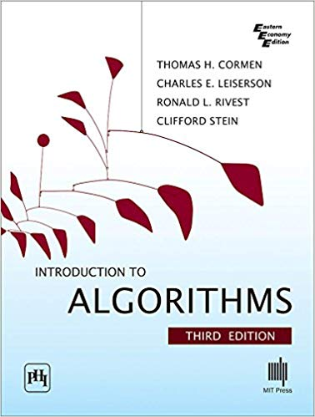
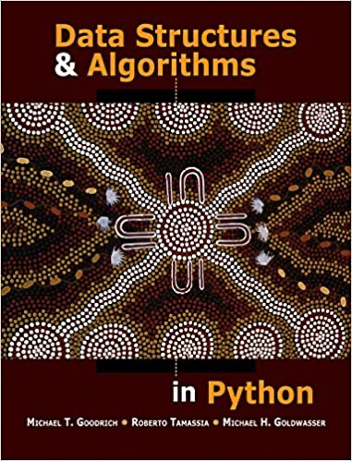
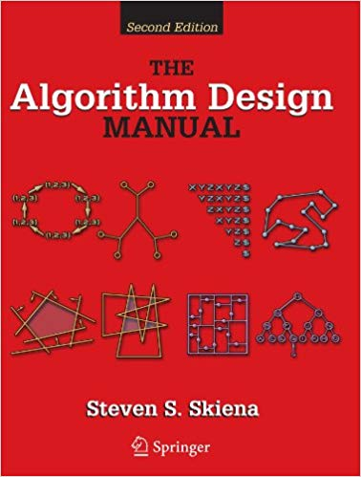
Reference Textbooks
[CLRS] Thomas H. Cormen, Charles E. Leiserson, Ronald L. Rivest, and Clifford Stein (2009). Introduction to Algorithms. 3rd ed. The MIT Press.
[GTG] Goodrich, M., Tamassia, R., Goldwasser M. (2013). Data Structures and Algorithms in Python. 1 ed. Wiley
[S] Skiena, S. S. (2008). The algorithm design manual. 2nd ed. Springer Science & Business Media.

Slide 4
Prerequisites
IT/CS or related background
Have a bit experience in programming

Slide 5
Course objective
Able to measure complexity using BigOh notations
Understand and apply standard algorithms for CS problem solving through paper exercises (classwork) and programming exercises (lab)
Able to compare and contrast different data structures (e.g., list, linked list, trees, graphs, etc.)

Slide 6
Course Outline and Timetable
Wk | Topic
1 | Introduction
2 | Algorithm analysis
3 - 4 | Recurrences
5 | Heapsort and Quicksort
6 | Counting, Radix, Bucksort
7 | Midterm
8 | Basic Data Structures
9 | Red Black Trees
10 | Graph Structures
11 | Single Source Shortest Paths
12 | All-Pairs Shortest Paths
13 | Greedy algorithms
14 | Dynamic Programming
15 | Final Exam

Slide 7
Grading Policy
Programming Assignment 10%
Python
Requires self-study.
No late work will be accepted
All assignments shall be submitted via Google classroom
First plagiarism will get zero. Second plagiarism will automatically get F.
Projects: 20%
Implement a python application demonstrating use of data structures and algorithms - no plagiarism
Midterm: 30% and Final: 40%
Exams will be open-book and open internet
Mainly paper exercises

